Slide 1



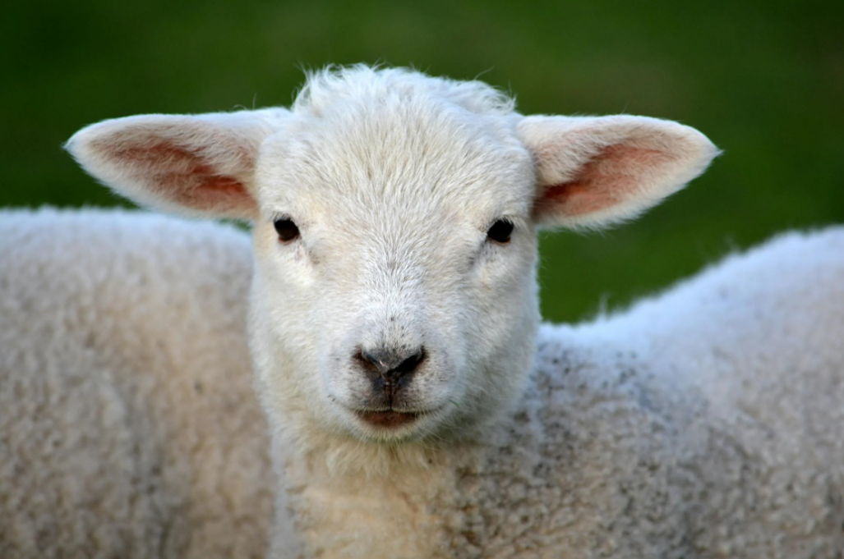
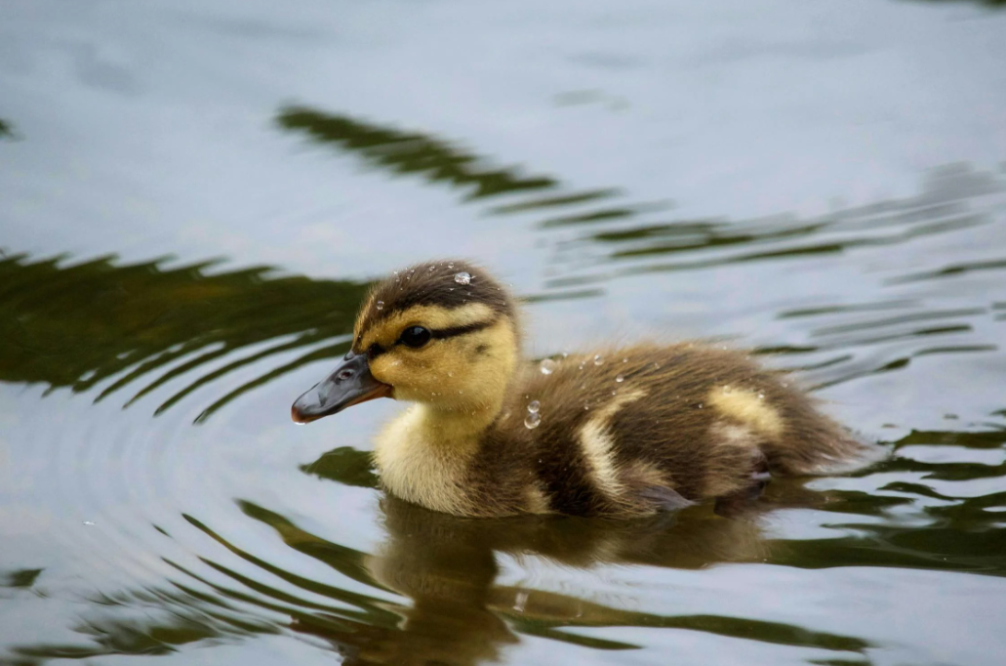
What is Easter all about?

Slide 2

It’s a celebration!

Slide 3
What is the worst thing that one person can do to another?

Slide 4
Tell your chosen version of the Easter story using a book, script or video up to the end of Good Friday

Slide 5
What is the worst thing that one person can do to another?

Slide 6
Hate
Fear of people who are different
Pride
Jealousy
Rage
(selfish anger)
Greed
Power hungry

Slide 7
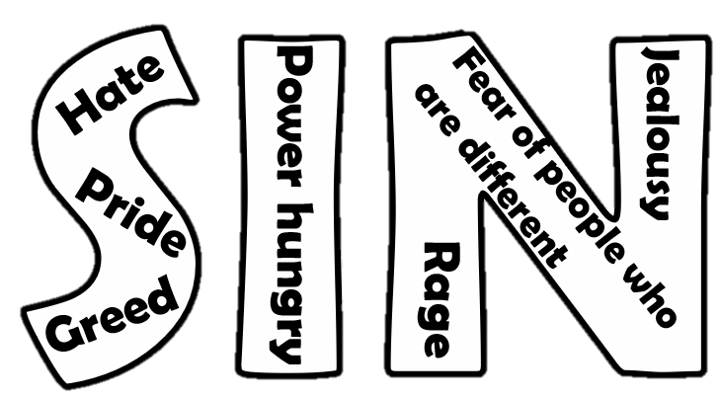
Hate
Jealousy
Fear of people who are different
Power hungry
Pride
Rage
(selfish anger)
Greed

Slide 8

People getting hurt
DEATH
>>>>>
>>>>>

Slide 9
Tell the rest of the Easter story

Slide 10

Why did Jesus agree to die?

Slide 11

He wanted to show us a new way to live and a way back to God.

Slide 12
getting hurt
DEATH
>>>>>
People

Slide 13
By loving others (including
listening to them) and saying no to
Saying sorry if we mess up
Forgive and be forgiven
Move forward and be happy

Slide 14
Dear Jesus,
Thank you that you came to Earth as a human to show us a new way to live and a way back to God.
Thank you for being brave and trusting in God on Good Friday.
We’re sorry for the part we play in making the world a less good place.
Help us to say no to sin and to love others as much as possible.
Thank you that we can be forgiven, move forwards and be happy.
Amen

