Slide 1

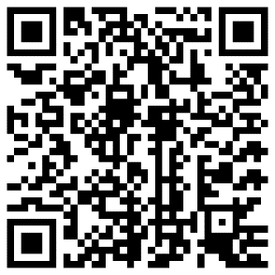
Spiritual Accompaniment

Slide 2
A chance to…
meet with someone to talk about your faith…
reflect on your experiences and beliefs
come to a deeper understanding of your relationship with God
feel supported, including through hard times
find greater freedom.

Slide 3
Profile
ecumenical and for all Christians
over 250 people accompanied
over 50 accompaniers
safer recruitment practised
training through blended learning
concentrated in Sheffield area
favours book cultures.

Slide 4
Or could you?
Offer this gift to others by
participating in our formation courses
being available
offering a listening ear
giving of your time, whether voluntarily, in return for a gift, or for payment.

Slide 5
To find out more
Use the QR code below or visit sheffdio.org/accompaniers
suzanna.upperdine @sheffield.anglican.org
Suzanna Upperdine Diocesan Church House 95-99 Effingham Street Rotherham S65 1BL
Suzanna 01709 309 147.

Slide 6
Spiritual Accompaniment

