Slide 1
Happy New Year!

Slide 2
What are you looking forward to this year?

Slide 3
What are you hoping to achieve or get better at this year?

Slide 4
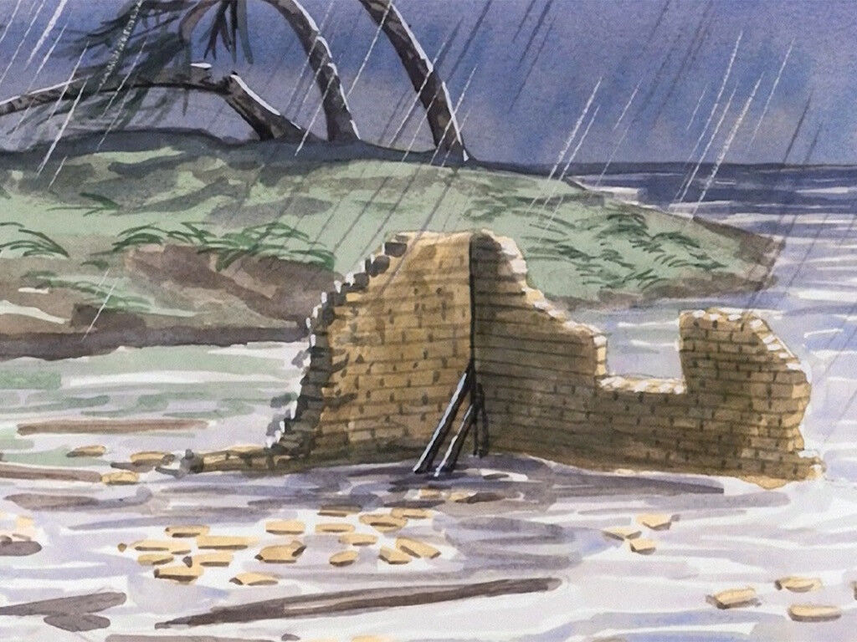

Slide 5
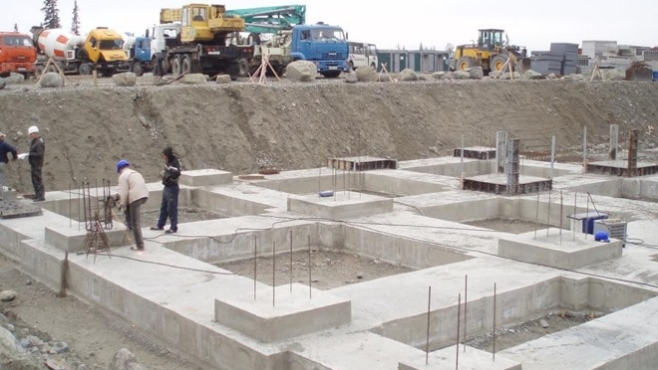

Slide 6
Good Foundations: – Find some good friends you can trust who will stick by you. – Don’t bottle up your worries: always talk to someone. –Read and listen to good advice. Try reading some more stories from the Bible because they often contain good advice.

Slide 7
One house with foundations dug squarely And one house built all willy-nilly. When the storms came along, The first house stood strong, But the second collapsed like a jelly!
(Lucy Moore, The Gospels Unplugged, BRF, 2008)

Slide 8
Dear God, Please help us to build our lives on firm foundations and to have a good year. Please help us to love and care for people as we go through the year. Amen.

