Slide 1
“Oh I would just be happy if I had that bike!”
“Why didn’t I get a certificate?”
“I only want Lily to play with me, she’s my friend!”
“I won’t say well done because I wanted to win!”

Slide 2
Video
Why Should We Be Happy For Others? (Dealing with Jealousy) | The Green-Eyed Monster - YouTube https://www.youtube.com/watch?v=ywrfxdrRGhw

Slide 3
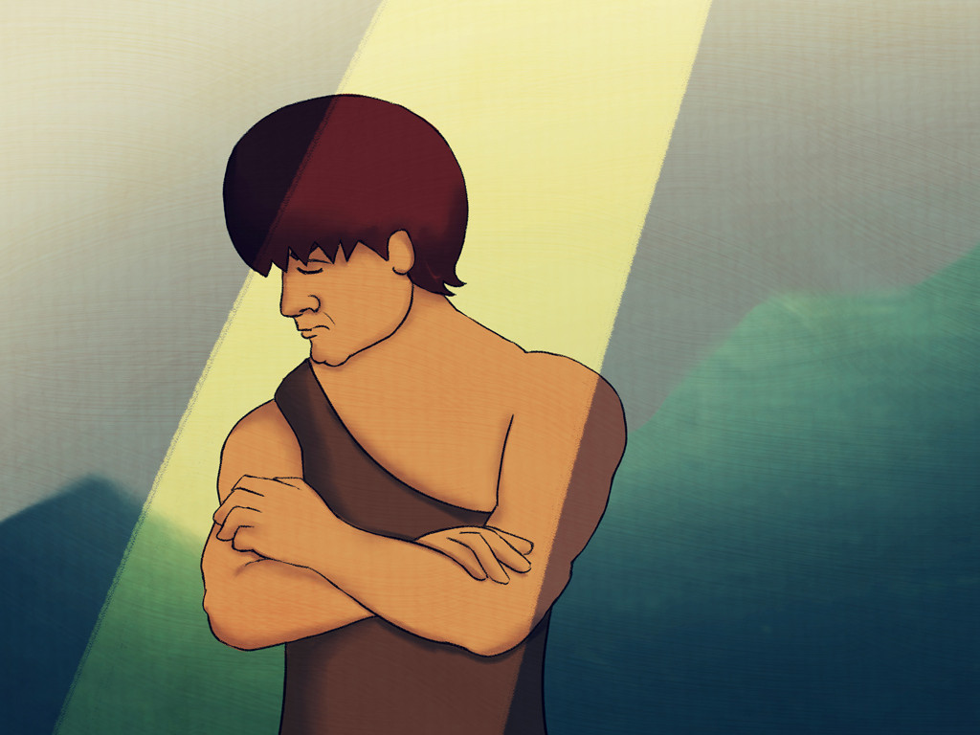
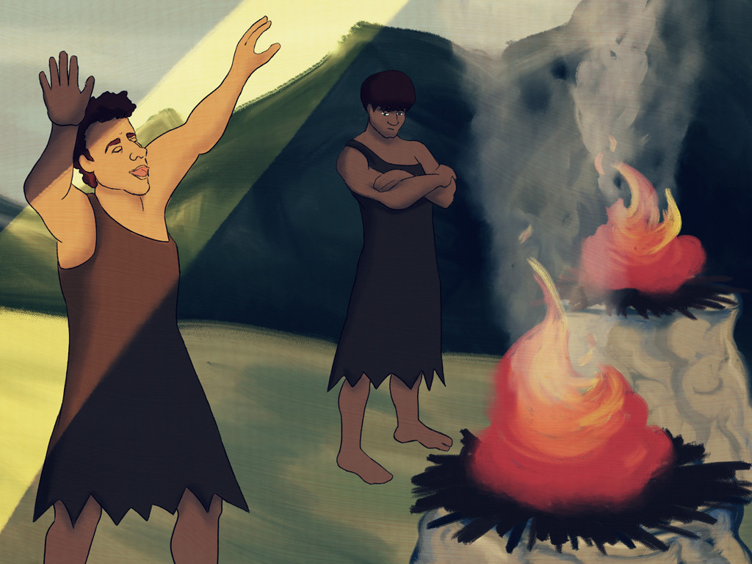
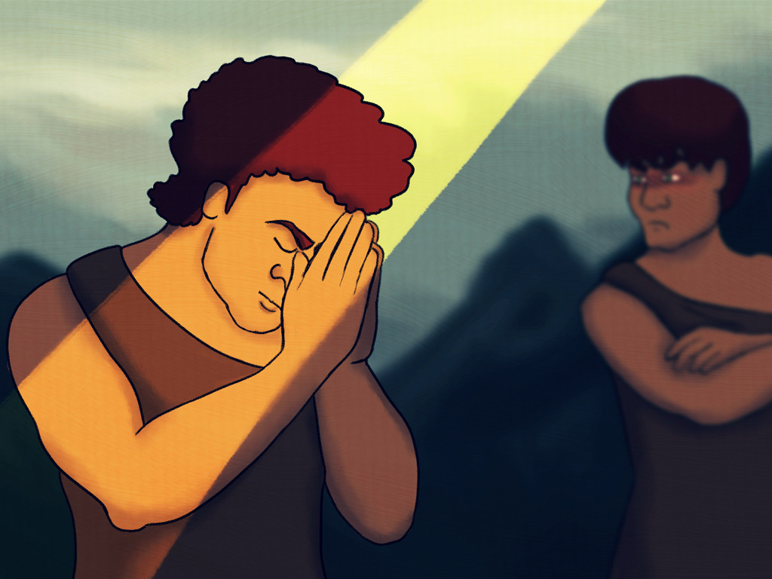
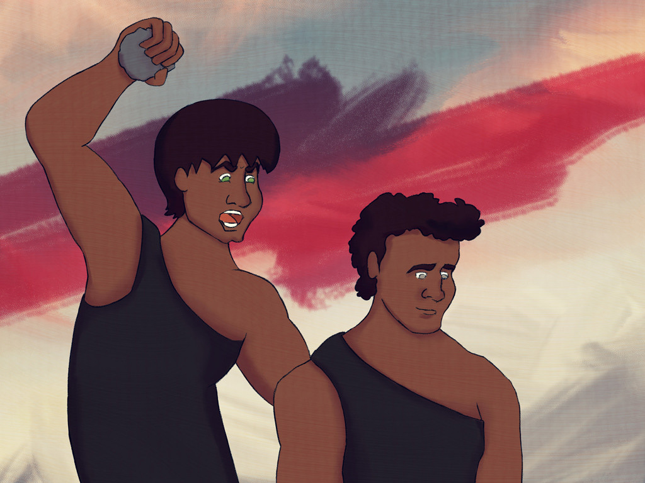
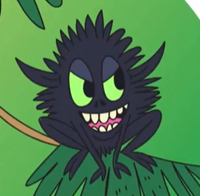

Slide 4

Jealousy can be a BIG feeling

Slide 5
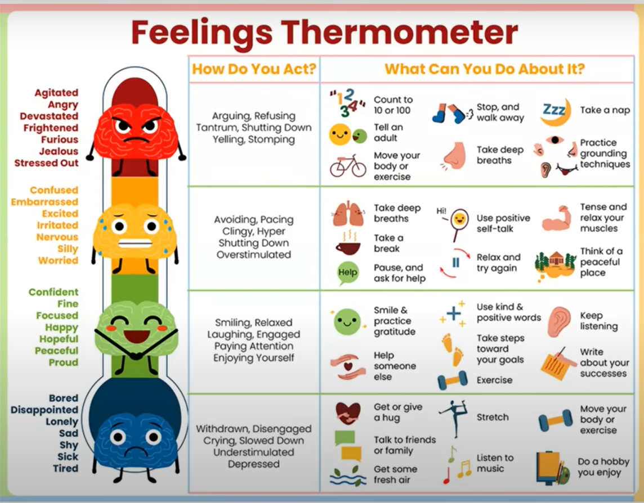

Slide 6
So how do we deal with jealousy?
Calm down first by: walking away, telling an adult, taking deep breaths
Say “No!” to the green-eyed monster and “No!” to the jealous thoughts
Be thankful for what we do have
Say “Well done!” and be happy for others
Keep trying hard and doing good things

Slide 7
Dear God,
We know that we all feel jealous sometimes and that there are times when we want something that someone else has.
Please help us to choose to be happy with who we are and what we have.
Please help us to be thankful.
Amen

